Slide 1
Genome sequencing of 2000 canids by the Dog10K consortium advances the understanding of demography, genome function and architecture
Journal Club
Jingxuan Chen, Oct 20, 2023

Slide 2
Dog10K Project
An international consortium aimed to build a comprehensive database for 10,000 whole canine genomes.
Lead by Yaping Zhang (KIZ), Robert Wayne (UCLA), and Elaine Ostrander (NIH) since November 2015.
Specific questions to address:
the evolutionary history of dogs;
genetic changes associated with domestication;
relationships of genetic changes to phenotype;
loci involved in canine susceptibility to disease among certain breeds.
http://www.dog10kgenomes.org/

Slide 3
Conclusion for this paper
Published a dense WGS dataset of ~2,000 canids and created resources of structural and single-nucleotide variants.
Surveyed patterns of SNV sharing, identifies likely functional variants, informs breed structure, and enables accurate imputation, etc.

Slide 4
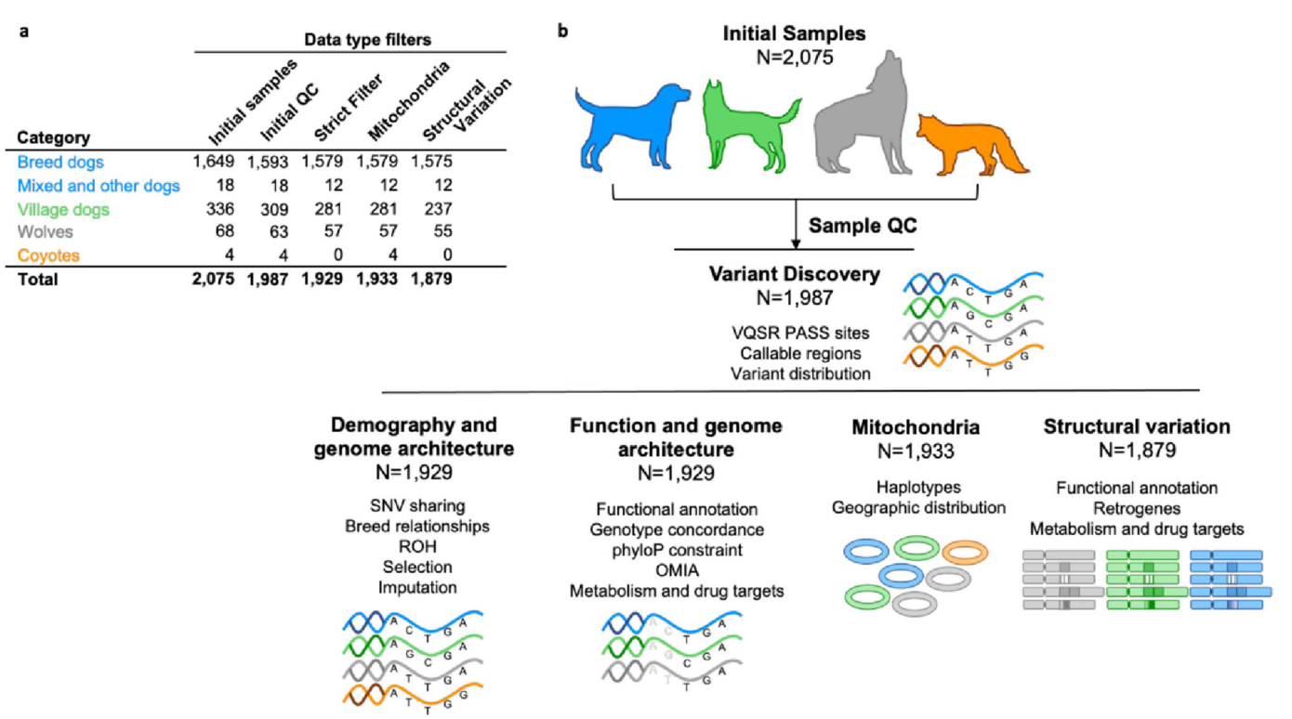
Figure 1
WGS
Illumina HiSeq X Ten
20X
150 * 150 bp
Low coverage (<10), duplicates, missing breeds, contamination
GATK &
Microarray genotyping
PLINK & PHYLIP
BCFtools & GLIMPSE &IMPUTE5 etc.
Mutect2
QuicK-mer2 & Manta & GraphTyper
Notes:
SNPs called by GATK,
variant quality score recalibration VQSR keeping 99% variants by Illumina CanineHD BeadChip and Axiom K9 HD genotyping arrays, involving 1929 samples
SV further filtered by unique depth profile

Slide 5
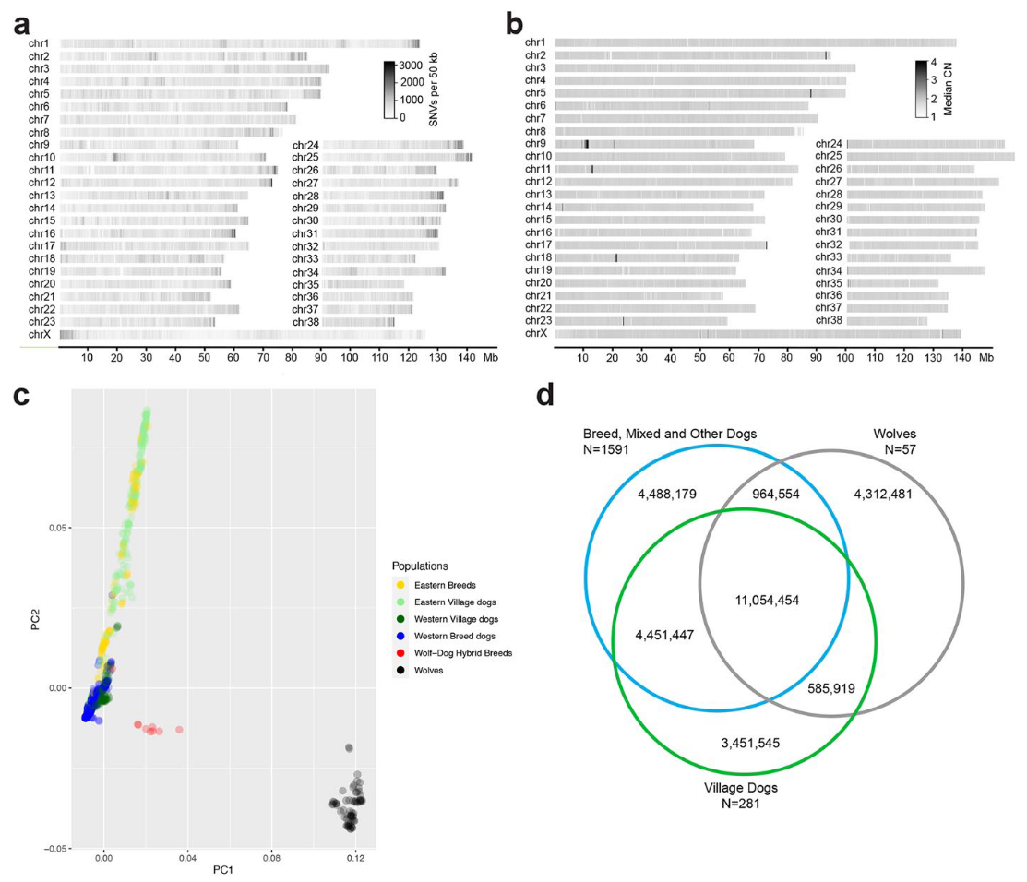
Figure 2
Notes:
Variant distribution across the genome. a SNV density in 50‑kb windows, drawn from 1987 samples. Increased SNV density is observed at the X‑PAR region and the ends of most autosomes. b Median copy number (CN) for 1824 dogs reveals a large, common duplication on chr9 relative to the reference genome. c Principal component (PC) analysis separates dog and wolf samples along the first axis while axis two separates dogs from Eastern and Western Eurasia. d SNV sharing between the three categories of samples

Slide 6
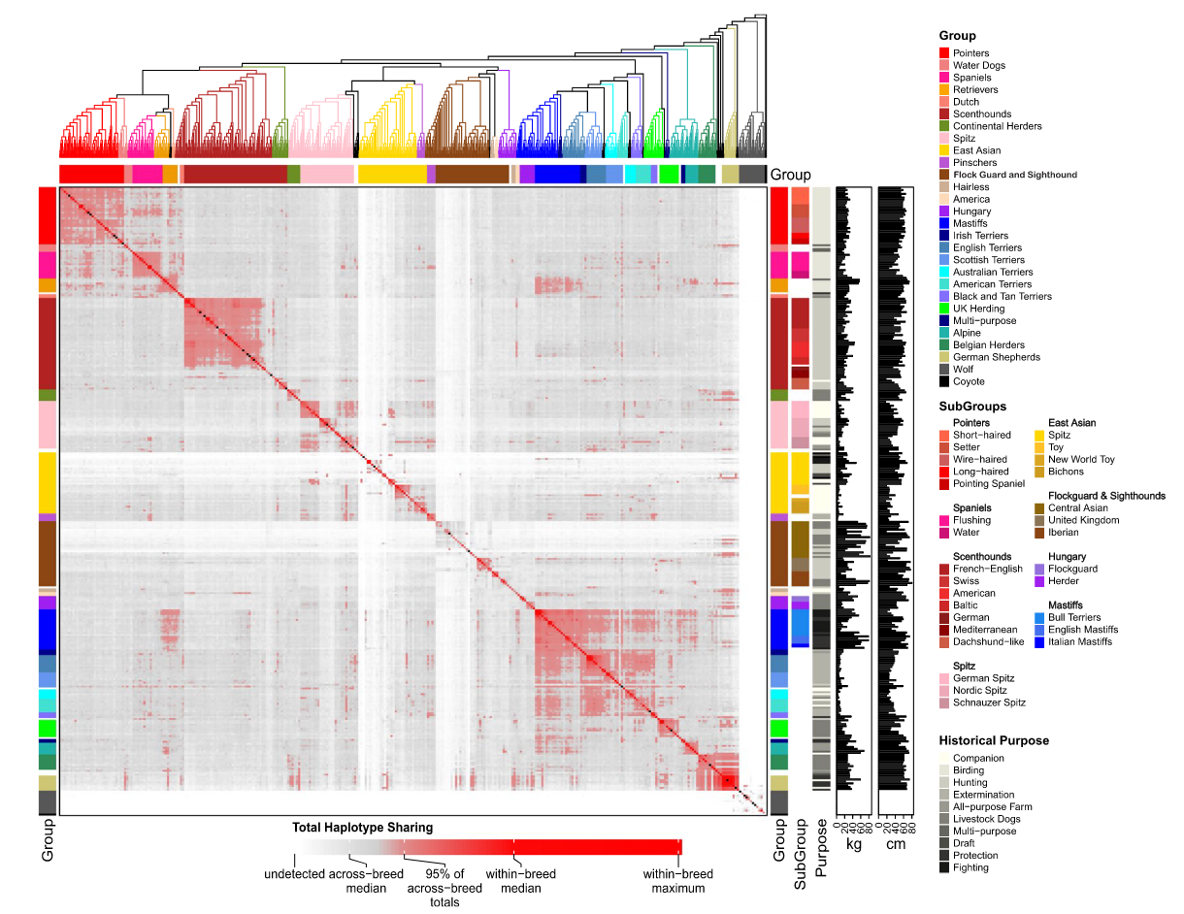
Figure 3
Notes:
Genetic relationships between 1563 samples spanning 292 breeds. The plot is annotated for major and minor breed groups, breed purpose, and key morphological features. The fraction of haplotype sharing is indicated by the heatmap
Samples are further filtered: Excluded if they 1) did not cluster with the multi-breed clade that contained all other member of the same breed; 2) they were listed as an ambiguous breed; or 3) they were part of a population that included first generation hybrids
Tree is colored by major clades
defined clades as clusters of two-49 breeds that share the same branch in > 65% of samplings, according sharing occupation, morphological traits, and/or geographic origin.
25 major clades were identified
95% of breeds form monophyletic clusters
haplotype sharing within breeds are 40 times greater than among breeds. 3.6 times greater within clades than among clades, 7-folder higher within subclades
1 Asian clade and flock-guard show lowest sharing
2. Terrier and mastiff clades show excess haplotype sharing, related to breed development: long-standing crossing
3. High between mastiff and retrievers, recent/ancient admixture
4. German shepherd shows high sharing within clade, and with multiple breeds from diverse clades. Also the only breed clade similar to wolf

Slide 7
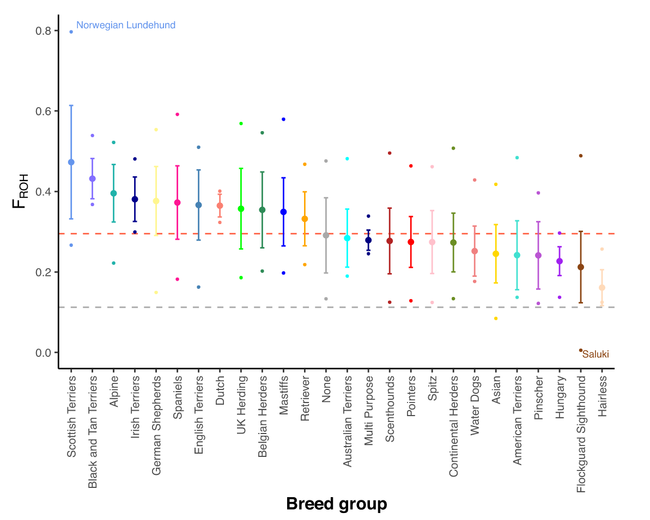
Figure 4
Notes:
Proportion of the genome covered by ROH. Mean and standard deviation are plotted for breed groups and are colored as per Fig. 3. Red dashed line shows mean FROH for breed dogs; gray dashed line shows mean FROH for wolves. Breeds containing individuals with the highest and lowest FROH are labeled
The estimated proportion of a genome(s) that is in ROH gives a measure of individual or population level inbreeding
Norwegian Lundehund had the largest number of ROH bases (total ROH =1842 Mb; FROH = 78.8%), while a Saluki (sighthound) had the fewest (total ROH =12.8 Mb; FROH = 0.56%).

Slide 8
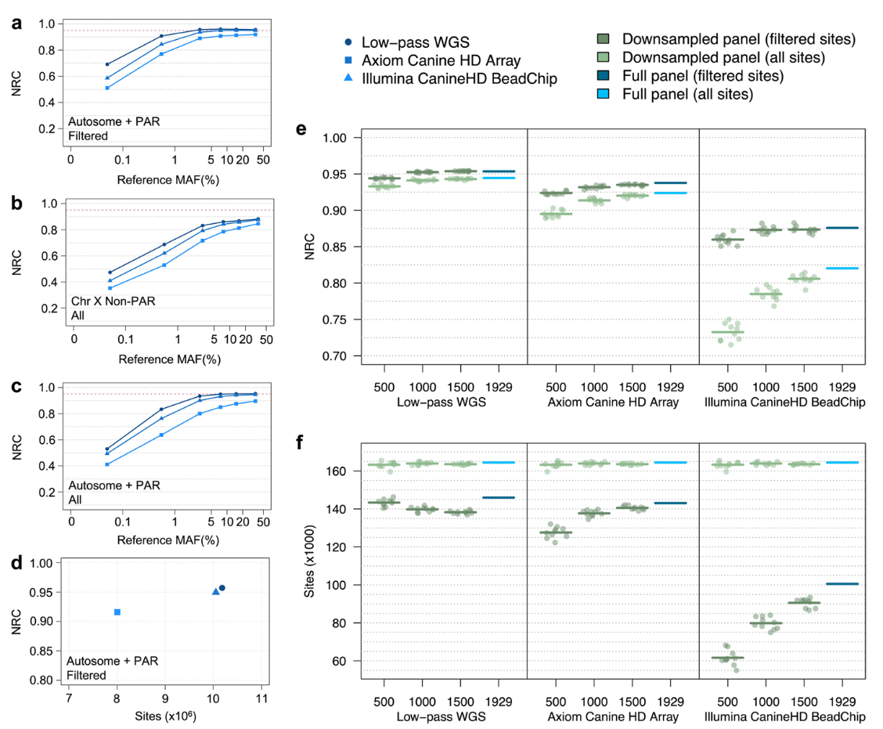
Figure 5
Notes:
Genotype imputation accuracy of the Dog10K reference panel. a NRC rates of imputed genotypes across autosomes and the PAR segment of chromosome X. Variant sites are filtered according to GLIMPSE and IMPUTE5 imputation quality scores (INFO > 0.9). b NRC rates of imputed genotypes across the non‑PAR segment of chromosome X. Variants are not filtered by imputation quality score, as imputation software does not provide scores for haploid genotypes. c NRC rates of imputed genotypes across autosomes and the PAR segment of chromosome X prior to filtering on imputation quality. d NRC rates and total number of imputed sites for each platform. Sites were filtered according to imputation quality score > 0.9 and reference MAF > 1%. e NRC rates for downsampled and full chromosome 38 reference panels for sites with reference MAF > 1%. Results show both quality and non‑quality filtered sites. Data points show NRC rates for a single downsampled reference panel. Horizontal bars indicate mean NRC rates for each reference panel population size. f Number of imputed variants for downsampled and full chromosome 38 reference panels for sites with reference MAF > 1%. Results show both quality and non‑quality filtered sites. Data points show the number of imputed variants for a single downsampled reference panel. Horizontal bars indicate the mean number of variants for each reference panel population size

Slide 9
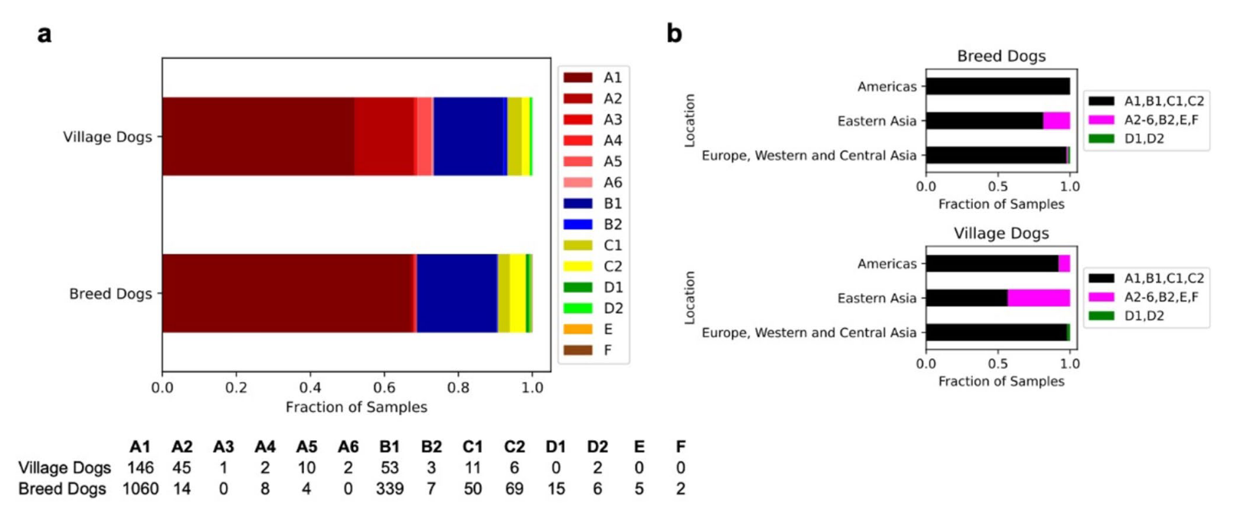
Figure 6
Notes:
Assignment and distribution of haplogroups in breed and village dogs. Each breed and village dog was assigned to an existing mitochondrial haplotype. Broad geographic categories based on sample origin

Slide 10
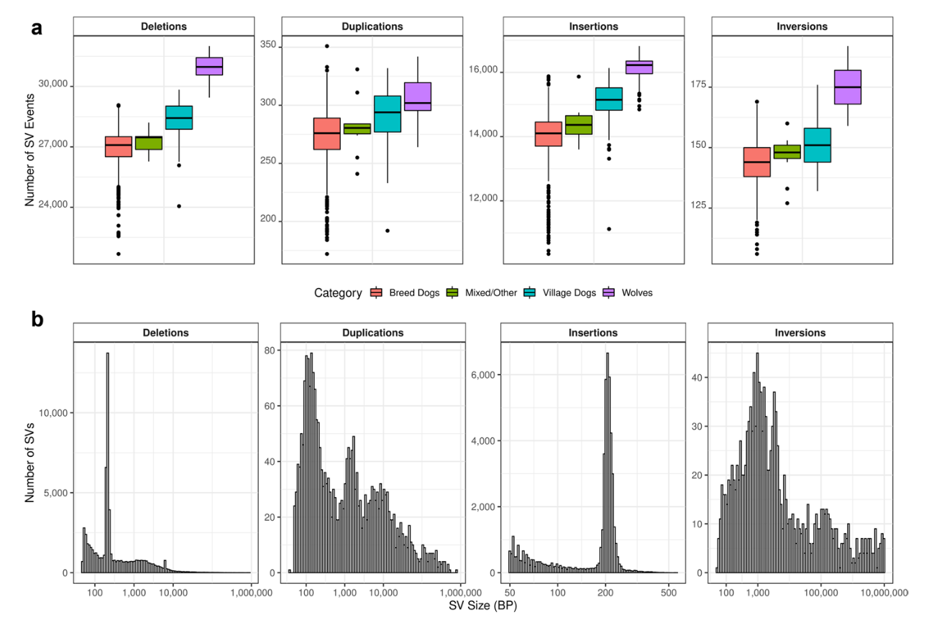
Figure 7
Notes:
Structural variation detected across 1879 samples. a Boxplots of the number of deletion, duplication, insertion, and inversion variants are shown broken down by sample category. b Histograms of the size distribution of each class of detected structural variants are shown. An increase in variant count at the ~ 200 bp size bin is apparent for deletions and insertions. This corresponds to the size of SINEC elements

Slide 11
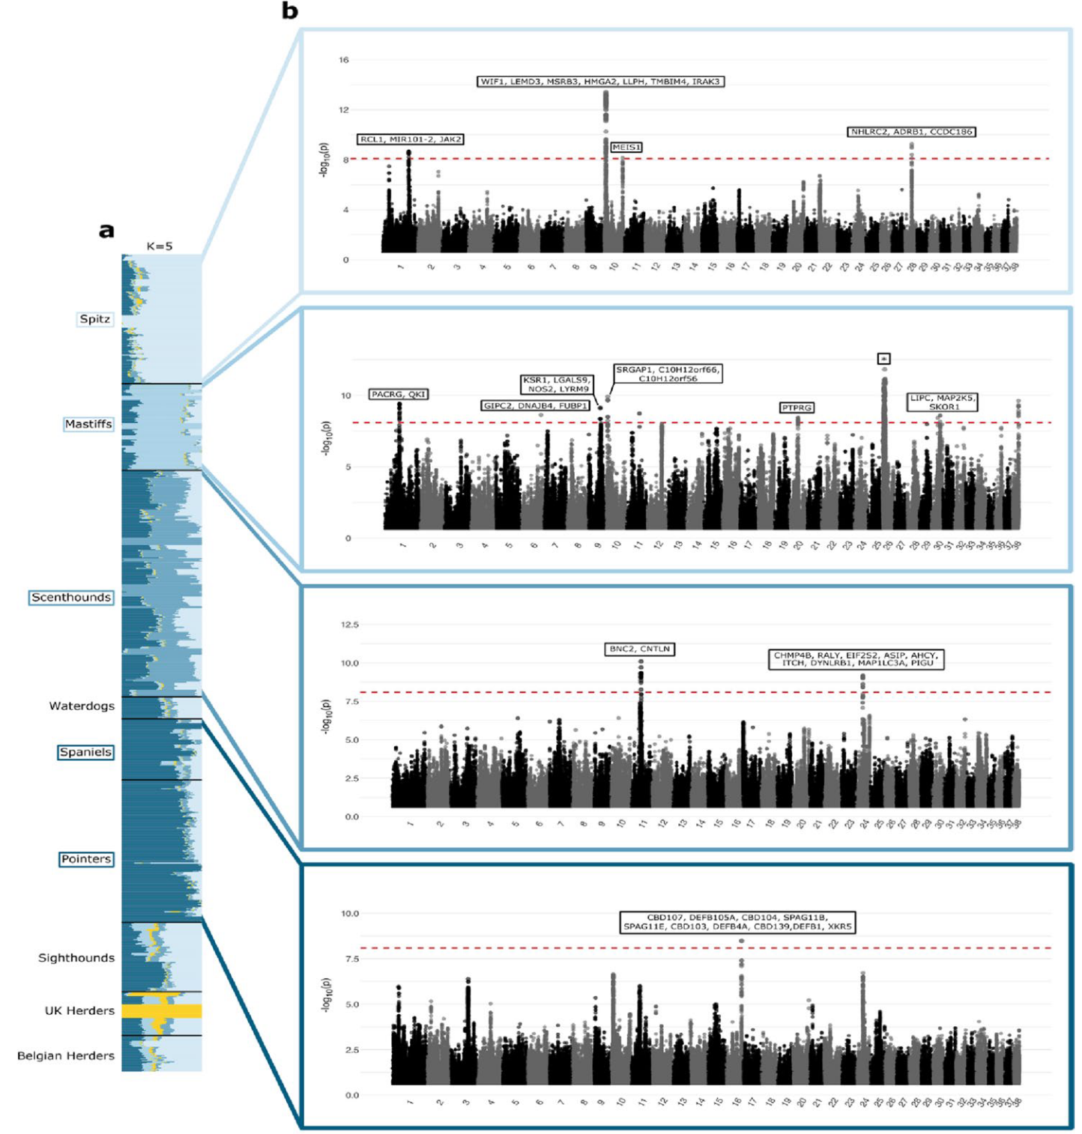
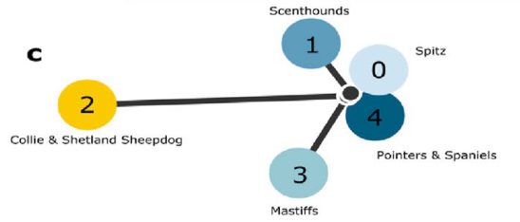
Figure 8
Notes:
Signatures of selection inferred with ancestry components. a Population structure inferred from Ohana for the nine selected dog groups using K = 5. b Manhattan plots for four of the five ancestral components. Top to bottom: Spitz, Mastiffs, Scenthounds, Pointers, and Spaniels. The red dotted line represents the Bonferroni cutoff and genes either overlapping or within 100 kb from a significant site are indicated at each peak. The asterisk within the Manhattan plot for the Mastiff component contains 88 candidate genes listed in Table S7. c Population tree connecting the ancestral components with colors corresponding to the ancestries are shown in the admixture plot. Each ancestral component is labeled based on the dog group(s) for which it is maximized

Slide 12
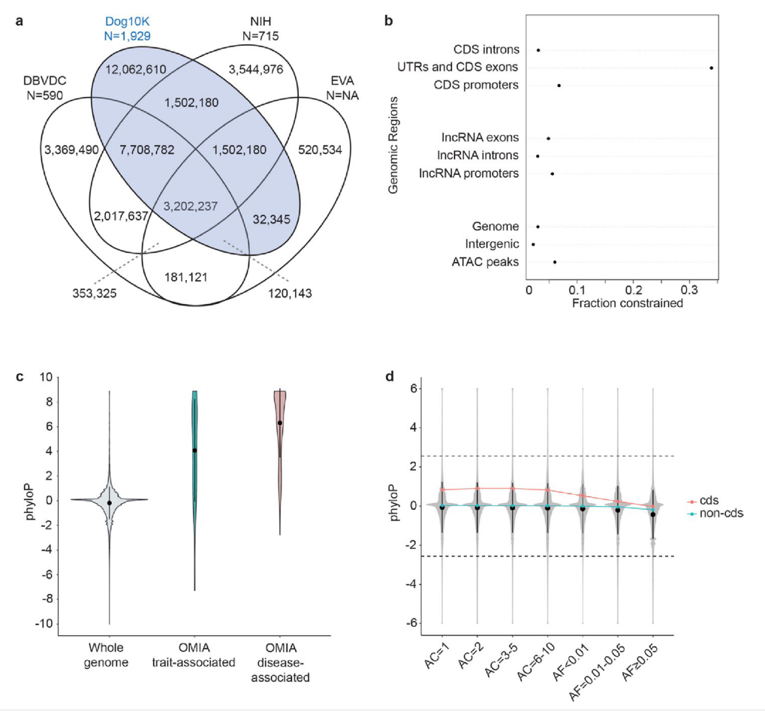
Figure 9
Notes:
Comparison among variant data sets. a Number of variable positions shared between major databases. b Fraction of genome spaces under constraint (5% FDR, phyloP > 2.56). c Enrichment of constrained bases in OMIA trait (blue), and disease (red) sets compared to the genome as a whole (gray). d Relationship between allele count (AC), allele frequency (AF), and phyloP score for the coding (CDS, red) and non‑coding (non‑CDS, green) bases in the whole genome (gray)
Online Mendelian Inheritance in Animals (OMIA) database
FDR (False Discovery Rate) is a concept used to control and quantify the rate of false discoveries in multiple hypothesis testing
The result is a PhyloP score, which can be either positive or negative. A positive PhyloP score indicates that the position is more conserved than expected, suggesting it may be under evolutionary constraint and potentially functionally important. A negative PhyloP score suggests the position has undergone more change (divergence) than expected under neutrality.

Slide 13
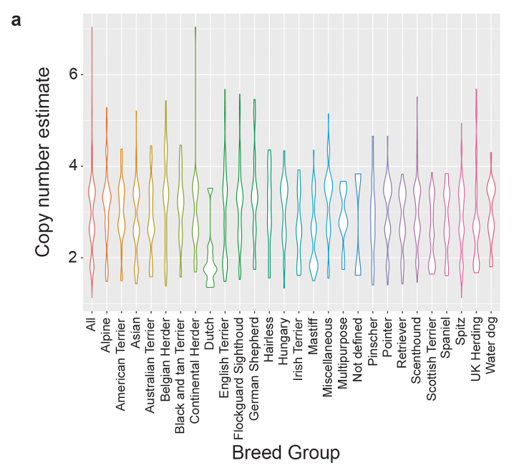
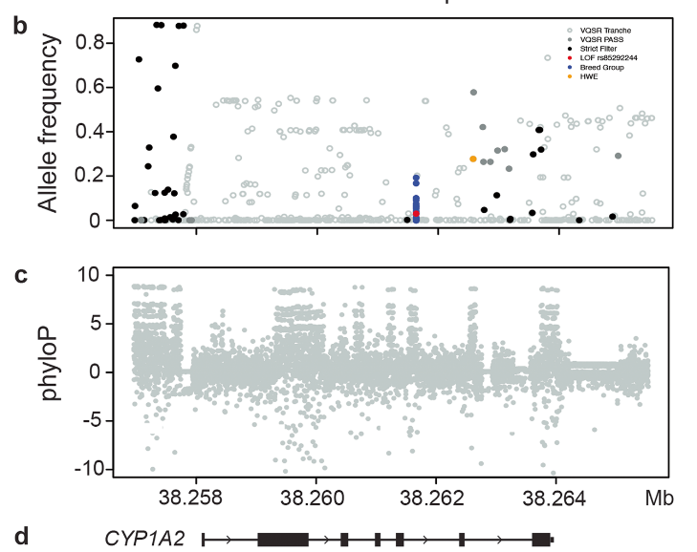
Figure 10
Notes:
Structural and point variants impacting CYP1A2. a Distribution of copy number variation within all breed dogs, and the major clades. b Location of SNVs across CYP1A2 inclusive of filtering or impact status. c Mammalian phyloP scores (bounded by 10, − 10). d Illustration of the region from the reference genome perspective
An example utility of Dog10K database

Slide 14
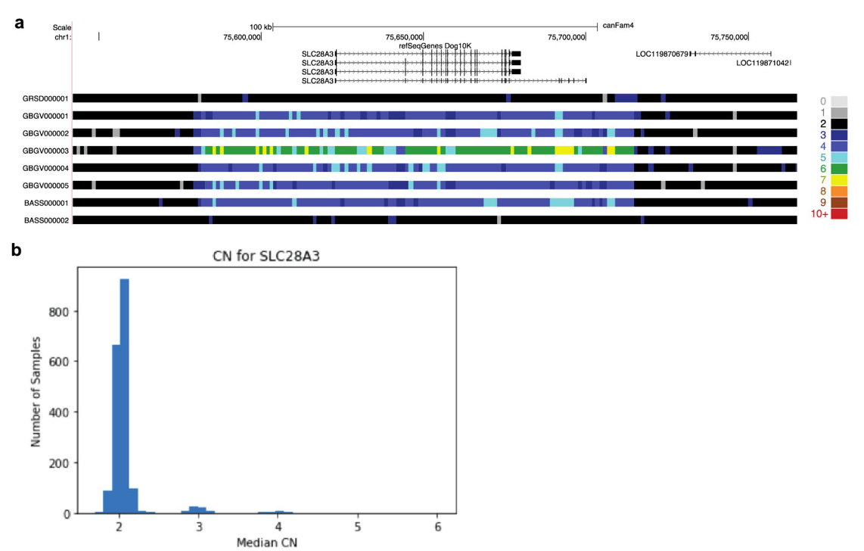
Figure 11
Notes:
SLC28A3 lcus copy number expansion. Location and span of the copy number element in polymorphic Grand Basset Griffon Vendéen (GBGV) and basset hound (BASS) individuals SLC28A3 contrasted with copy number two samples from the German Shepherd Dog (GRSD) and BASS breeds. b Distribution of the median copy number count across the 1879 samples assayed

